Slide 1

JAWAHARLAL NEHRU TECHNOLOGICAL UNIVERSITY HYDERABAD UNIVERSITY COLLEGE OF ENGINEERING SCIENCE AND TECHNOLOGY
DEPARTMENT OF COMPUTER SCIENCE
AGENTIC ORCHESTRATION FOR AUTONOMOUS SOFTWARE
ENGINEERING WORKFLOWS
DISSERTATION WORK REVIEW – 1
AUGUST-2026
UNDER THE SUPERVISION OF
Dr. M. Dhanalakshmi
Professor of CSE Department
& Coordinator DAP
JNTUH-UCESTH
PRESENTED BY
R. Rajasri
22011P0526
5th Year - 1st Sem
CSE-IDP

Slide 2
ABSTRACT
Software engineering automation remains limited, as existing AI tools mainly handle isolated tasks such as code generation and still require human intervention for integration, testing, and deployment.
The proposed framework automates the software lifecycle from natural-language requirements to deployment using specialized agents for coding, testing, debugging, and deployment, supported by vector-based knowledge retention and risk-aware human intervention for uncertain or high-risk decisions.

Slide 3
INTRODUCTION
With the growing adoption of AI in software engineering, achieving reliable end-to-end automation with minimal human intervention remains a significant challenge.
The proposed work addresses dynamic planning, specialized agents, knowledge retention, and tool integration, enhanced by a risk-aware human-in-the-loop mechanism that enables intervention for high-risk tasks.

Slide 4
PROBLEM STATEMENT
To build a multi-agent software development system that automatically manages the complete software lifecycle through dynamic task planning, specialized agents for coding, testing, debugging, and deployment, vector-based knowledge retention, and risk-aware human intervention.

Slide 5
OBJECTIVES
Design a multi-agent architecture for end-to-end SDLC automation.
Develop dynamic task planning and coordination among specialized agents.
Implement vector-based knowledge retention for cross-project learning.
Integrate industry-standard tools for automated testing, version control, and deployment.
Develop a risk-aware decision mechanism with confidence scoring and human intervention for high-risk tasks.
Evaluate automation performance, reliability, and risk-handling across different software projects.

Slide 6
LITERATURE REVIEW
SYSTEM / PAPER | APPROACH | LIMITATIONS
ChatDev | Multi-agent software development using role-specialized agents for design, coding, and testing. | Limited focus on risk-aware decisions, reliable human intervention, and chat-based interaction.
AutoGPT | Autonomous agent that decomposes goals into subtasks and executes them using tools. | General-purpose autonomy; lacks structured role-based SDLC coordination.
AgentCoder | Uses programmer, test-designer, and test-executor agents with iterative feedback for code generation. | Mainly focuses on code generation and testing rather than the complete SDLC.

Slide 7
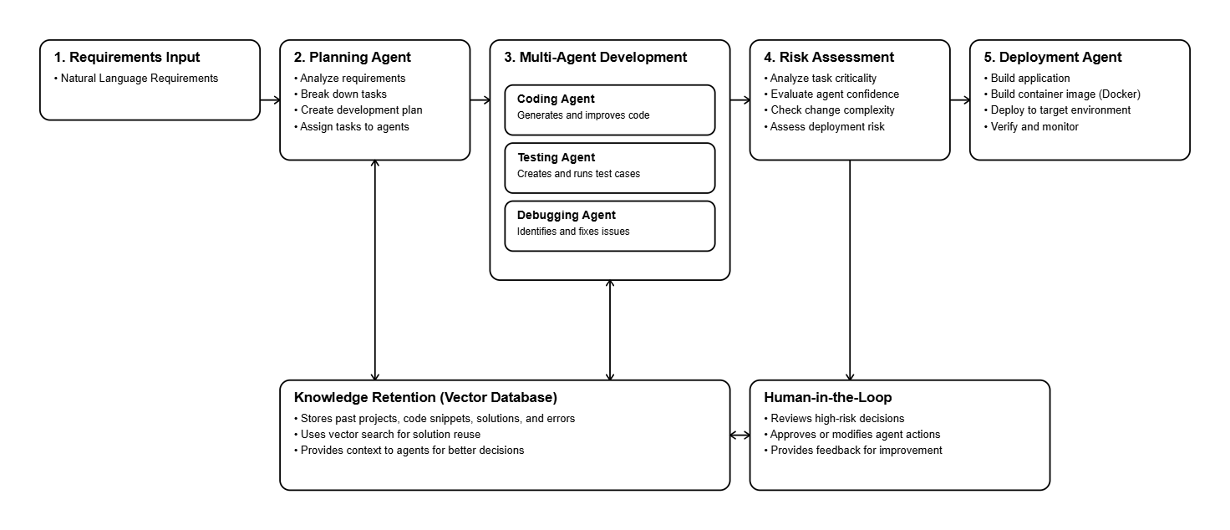
PROPOSED ARCHITECTURE

Slide 8
TECHNOLOGY STACK
Language: Python
Agent orchestration: LangGraph, LangChain
LLM / RAG: Gemini, Sentence Transformers, RAG
Vector DB: ChromaDB
Risk engine: Rule-based risk scoring + confidence thresholds
Human-in-the-loop: LangGraph checkpointing/interrupts
Backend: FastAPI
Frontend: React
Testing: pytest
DevOps: Git, GitHub, Docker
Storage: PostgreSQL

Slide 9
EVALUATION METRICS
End-to-End Success Rate: percentage of software development tasks successfully completed from natural-language requirements through testing and deployment.
Human Intervention Rate: percentage of development tasks requiring human intervention, including manual approval, code modification, or failure resolution.
Development Time: total time taken from requirement submission to successful completion and deployment, averaged across all benchmark tasks.
Re-planning Success Rate: percentage of failed tasks successfully resolved after the system dynamically changes the task decomposition or execution plan rather than repeating the same approach.
Risk-Decision Accuracy: percentage of risk-based decisions correctly classified as safe for autonomous execution or requiring human escalation, measured against manually labeled ground truth.

Slide 10
CONCLUSION
The proposed multi-agent framework integrates dynamic planning, specialized coding, testing, debugging, and deployment agents with RAG-based knowledge retention and risk-aware human intervention. This enables more reliable end-to-end software automation while reducing development time and unnecessary human involvement.

Slide 11
REFERENCES
[1] C. Qian et al., “ChatDev: Communicative Agents for Software Development,” Proceedings of the 62nd Annual Meeting of the Association for Computational Linguistics (ACL), pp. 1517415186, 2024 Paper – ACL Anthology
[2] S. Hong et al., “MetaGPT: Meta Programming for A Multi-Agent Collaborative Framework,” International Conference on Learning Representations (ICLR), 2024 Paper – ICLR Proceedings
[3] J. He, C. Treude, and D. Lo, “LLM-Based Multi-Agent Systems for Software Engineering: Literature Review, Vision, and the Road Ahead,” ACM Transactions on Software Engineering and Methodology, vol. 34, no. 5, pp. 1–30, 2025, doi: 10.1145/3712003.
[4] Q. Wu et al., “AutoGen: Enabling Next-Gen LLM Applications via Multi-Agent Conversation,” ICLR 2024 Workshop on Large Language Model Agents, 2024.
[5] C. E. Jimenez et al., “SWE-bench: Can Language Models Resolve Real-World GitHub Issues?” International Conference on Learning Representations (ICLR), 2024.

Slide 12
THANK YOU

